Slide 1
AIR POLLUTION & ITS EFFECTS
HOW TO TACKLE THEM

Slide 2
WHAT IS AIR POLLUTION
AIR POLLUTION IS THE PRESENCE OF SUBSTANCES IN THE ATMOSPHERE THAT ARE HARMFUL TO HEALTH OF HUMANS AND OTHER LIVING BEINGS, OR CAUSE DAMAGE TO THE CLIMATE OR MATERIAL.
VARIOUS TYPES OF POLLUTANTS INCLUDE GASES, PARTICULATE MATTERS, BIOLOGICAL MOLECULES.
AIR POLLUTION CAUSES DISEASES, ALLERGIES AND EVEN DEATH TO HUMANS AND OTHER ORGANISMS AND DAMAGE FOOD CROPS AND PLANTS.
INDOOR AIR POLLUTION AND POOR AIR URBAN QUALITY ARE LISTED AS TWO OF THE WORLD’S WORST TOXIC POLLUTION PROBLEMS IN 2008.

Slide 3
TYPES OF AIR POLLUTION
INDOOR AIR POLLUTION IS WHEN POLLUTANTS FROM THINGS SUCH AS GASES AND PARTICLES CONTAMINATE THE AIR INDOORS.
INDOOR AIR POLLUTION IS A VERY REAL AND DANGEROUS THING BECAUSE INDOOR AIR IS FAR MORE CONCENTRATED WITH POLLUTANTS THAN OUTDOOR AIR.
APPROXIMATELY 4.3 MILLION DEATHS ARE REPORTED EACH YEAR DUE TO INDOOR POLLUTION.
INDOOR AIR POLLUTION HAS FAR GREATER IMPACT ON DEVELOPING COUNTRIES THAN IT DOES ON DEVELOPED ONES BECAUSE FUEL SUCH AS WOOD, CHARCOAL AND ANIMAL DUNG ARE BURNED INSIDE HOMES WHICH HAVE RARELY PROPER VENTILATION.

Slide 4
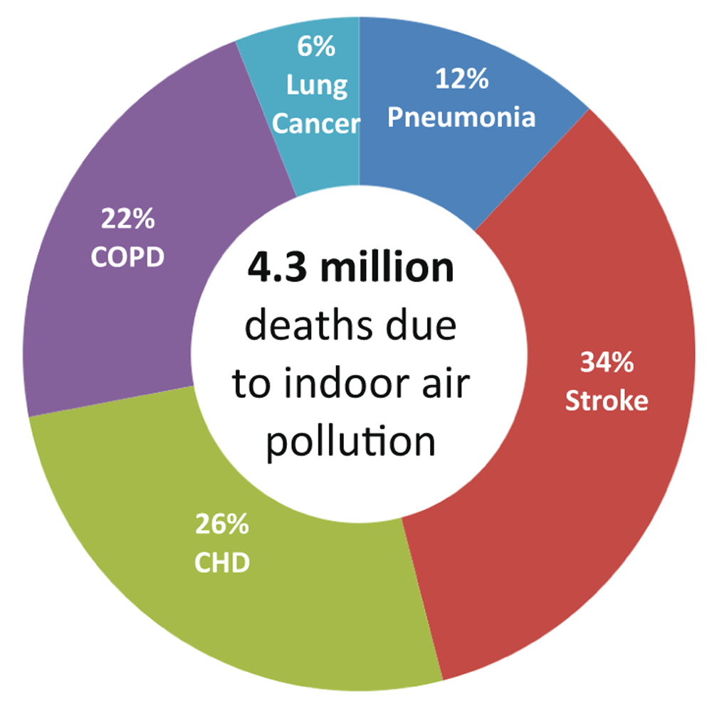

Slide 5
Causes for indoor air pollution
USE OF TOXIC PRODUCTS CALLED “VOLATILE ORGANIC COMPUNDS”.
INADEQUATE VENTILATION
UNEVEN TEMPERATURE AND HUMIDITY
SMOKING TOBACCO INDOORS
BURNING OF FOSSIL FUELS WITHIN CLOSED COMPOUNDS
USE OF WOOD STOVE OR SPACE HEATER

Slide 6
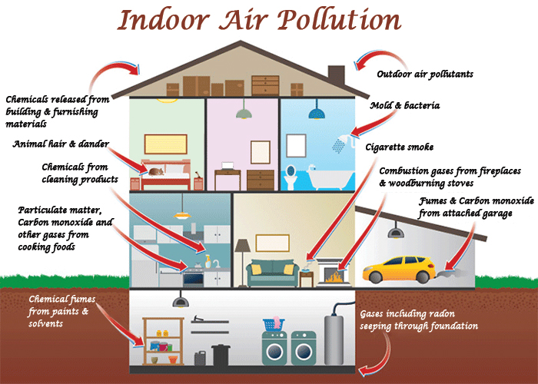

Slide 7
OUTDOOR AIR POLLUTION IS THE TYPE OF AIR POLLUTION IN WHICH LARGE AMOUNT OF UNWANTED PARTICLES POLLUTE THE OUTDOOR AIR OR THE AMBIENT AIR.
ITS CAUSED BY THE EMISSIONS OF BOTH MOBILE AND STATIC SOURCES.
THEY TEND TO BE SEVERE, AS THERE IS AN INCREASING TREND OF OUTDOOR AIR POLLUTION.
IT LEADS TO SEVERE HARMFUL EFFECTS OF OUR PERSONAL AND SURROUNDING NATURE AND ENVIRONMENT.
THIS PROCESS USED TO BE SLOW AND REVERSIBLE EARLIER, BUT IN TODAY’S WORLD, WITH INCREASING POPULATION, INDUSTRIES, VEHICLES, BURNING OF FUELS, ETC HAVE LEAD TO A SUDDEN UPSURGE IN THE DETERIORATION OF THE ATMOSPHERE.

Slide 8
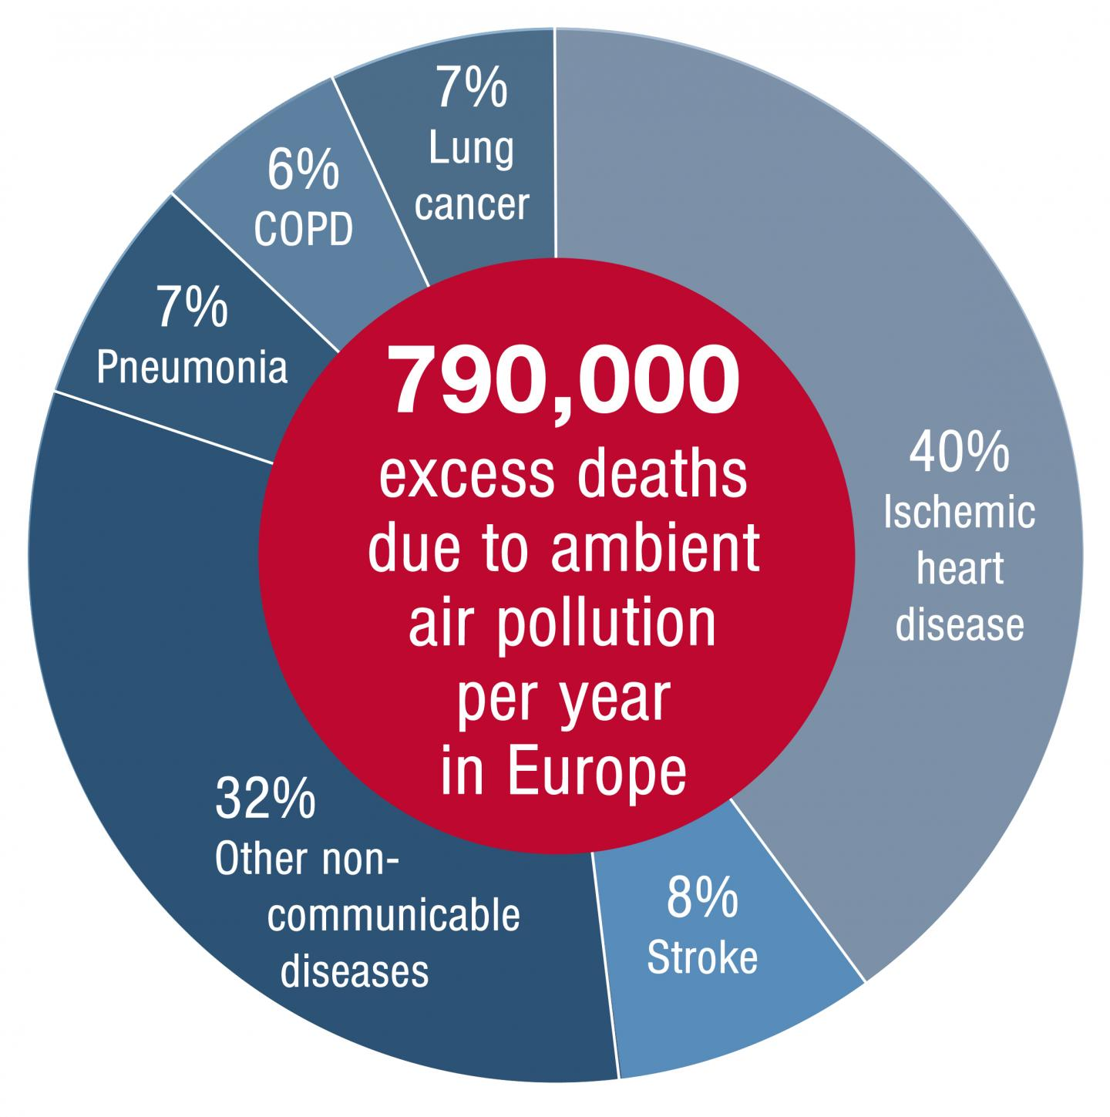

Slide 9
CAUSES FOR OUTDOOR AIR POLLUTION
FUMES FROM –PAINTS, HAIRSPRAY, VARNISH, AEROSOL SPRAYS AND OTHER SOLVENTS, VEHICLE AND INDUSTRIAL EXHAUST.
WASTE DEPOSITION IN LANDFILLS –GENERATES METHANE, THAT FORMS EXPLOSIVE MIXTURE WITH AIR. METHANE IS ALSO AN ASPHYXIANT DISPLACES OXYGEN IN ENCLOSED SPACES.
MILITARY RESOURCES –NUCLEAR WEAPONS, TOXIC GASES, GERM WARFARE AND ROCKETRY.
FERTILIZED FARM LANDS- MAJOR SOURCE OF NITROGEN OXIDES
VOLCANIC EMISSIONS
WILDFIRES/FOREST FIRES

Slide 10
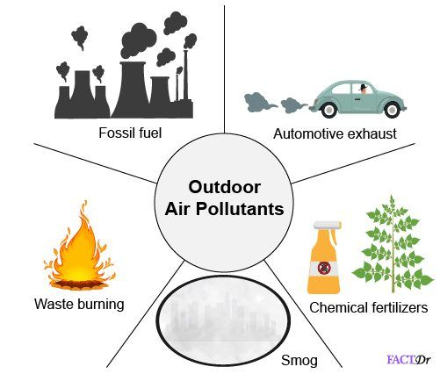

Slide 11
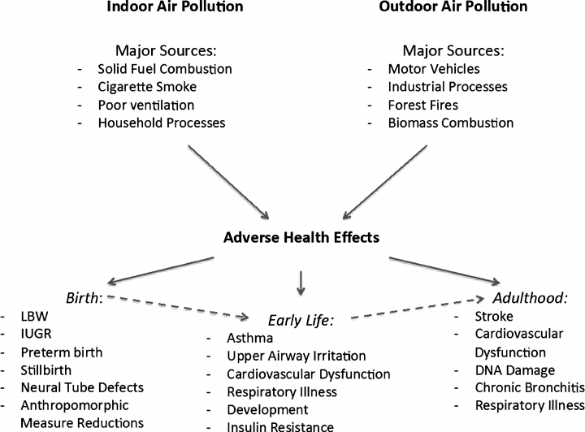
EFFECTS OF AIR POLLUTION ON HUMANS

Slide 12
THE IDEAS THAT WE PROPOSE
CONVERSION OF ATMOSPHERIC CARBON INTO USEFUL SUBSTANCES LIKE GRAPHITE AND DIAMOND THROUGH COMPRESSION
PUT FORWARD STRICT LAWS FOR INDUSTRIAL EMISSIONS
PROPER DESIGNED HOMES TO REDUCE INDOOR POLLUTION
USE OF LNG AND CNG INSTEAD OF FIREWOOD AND COAL IN HOUSES
IMPLEMENT STRICT LAWS FOR TESTING POLLUTION LEVELS IN AUTOMOBILES
EMPOWER THE REASEARCH FACILITIES THAT CONCENTRATE ON HEALTH ISSUES CAUSED BY AIR POLLUTION

Slide 13
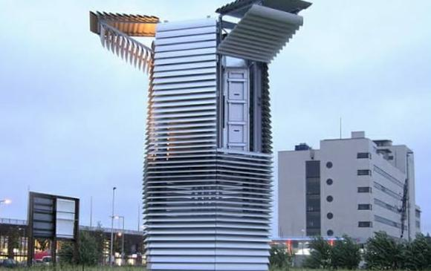
THE SMOG FREE TOWER
> This tower is situated in Biejing
> The tower absorbs smog from the atmosphere
The smog particles filtered by the tower are compressed for 30 minutes and turned into dark, boxy gems. The diamonds are then used for rings and cufflinks, each representing 1,000 cubic meters of pollution. Roosegaarde says a couple even used a smog ring as an engagement ring.

Slide 14
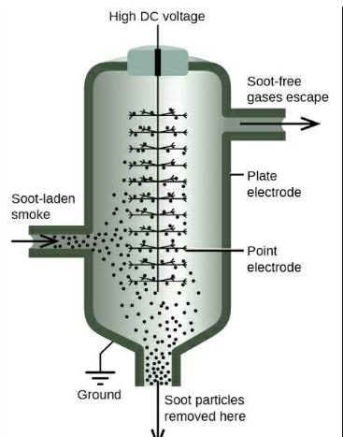
COTTREL SMOKE PRECIPITATOR
The emission of industries can be reduced by implementing a cottrel smoke precipitator
It consist of an electrostatic precipitator (ESP) which is a filtration device that removes fine particles,like dust and smoke,from a flowing gas using the force of an induced electrostatic charge minimally impeding the flow of gases through the unit.

Slide 15
tips to reduce indoor pollution
> Avoid smoking indoors (but quitting smoking is the best answer for overall health).
> Use craft supplies in well-ventilated areas.
> Make sure your gas stove is well-ventilated.
> Minimize clutter.
> Remove carpeting if possible.
> Use a dehumidifier and/or air conditioner to reduce moisture.

Slide 16
conclusion
The health of the public, especially those who are the most vulnerable, such as children, the elderly and the sick, is at risk from air pollution, but it is difficult to say how large the risk is. It is possible that the problem has been over-stressed in relation to other challenges in the field of public health.
We do have solutions for everything ,we just have to utilize our time and effort to solve such issues.

